Slide 1
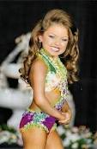
Sexual Violence and Hypersexualization in the 21st Century

Slide 2
Define Sexual Violence

Slide 3
Sexual Violence
Is “any form of non-consensual or forced sexual activity or touching, including rape…”(Rubin 2008: 7).
Examples may include (but are not limited to):
Rape
Inappropriate touching
Bra snapping
Wedggies
Sexual comments, etc.

Slide 4
Statistics
Sexual Harassment is both one of the most common, yet least recognized forms of sexual violence against women…87% of Canadian women report experiencing sexual harassment.
(Minerson et al. 2011: 15).

Slide 5
More Stats.
“Women who have experienced intimate partner violence are more likely to have poorer health than women who have never been abused.”
“In addition to human and social costs, the economic cost of violence- including the direct costs to health, legal, police and other services- is substantial. The cost of intimate partner violence in the United States alone is estimated to exceed $5.8 billion per year.”
(The Global Coalition on Women and Aids 2011: 3-5).

Slide 6
Even More Stats
In 2004, only 8 percent of Canadians that were sexually assaulted in the past 12 months reported the incident to police, compared to 39 percent of those who were physically assaulted and 46 percent of those who were victims of robbery.
“Most victims of sexual assault are young- 44 percent of those who had experienced sexual assault were aged 15- 24”
(McFadyen 2009: 1-5)

Slide 7
Myths About Sexual Violence
Myth: Most sexual assaults are perpetrated by strangers
Fact: in 80% of sexual assaults, the victim knew the perpetrator. Stranger assault does occur, but it accounts for 20% and is the least common.

Slide 8
Myths Continued…
Myth: most sexual assaults occur in places other than a private home, such as a dark ally or park.
Fact: more than half of reported sexual assualts occur in private homes, with the majority being in the victim’s home. Another common location is the perpetrators car.

Slide 9
More Myths…
Myth: Women often falsely accuse men of sexual assault or rape to get back at them or because they feel guilty about having sex.
Fact: although false reporting does exist, it is very rare. Sometimes victims choose to recant their statement, not because it was false, but often because they feel embarrassed, ashamed, or that they won’t be believed.

Slide 10
Even More Myths
Myth: Only women are sexually assaulted and only by men.
Fact: Both men and women can be sexually assaulted. In one study involving college men age 19-24, 30% admitted being survivors of sexual assault. Perpetrators can be either male of female and of any sexual orientation. Remember, sexual assault is about power, manipulation, and control over the victim; not sex.

Slide 11
The Truth About Myths Is…
Myth: If a sexual assault victim has no physical injuries and isn’t showing visible signs of trauma, they are ok.
Fact: Being sexual assaulted changes a person’s self perception, their feelings about trusting others, how they relate to their partner, and how they feel about their own body. Emotional pain can take months or ever years to heal. There is no right way to react to sexual assault, everybody copes differently.

Slide 12
What are common opinions about what it is to be a “real” woman today?

Slide 13
Feminism
definition

Slide 14
What are common opinions about what it is to be a “real” man today?

Slide 15
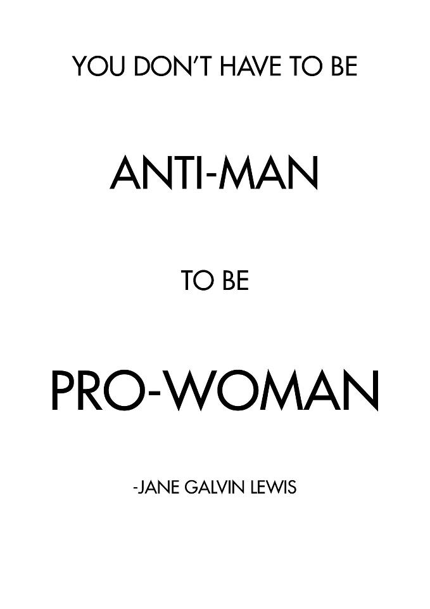
Masculinity
definition

Slide 16
What do you think Hypersexualization means?

Slide 17
Advertisements in the 21st Century

Slide 18
Abercrombie & Fitch

Slide 19
Abercombie & Fitch

Slide 20
Unnecessary Marketing

Slide 21
American Apparel

Slide 23
Hypersexualized Lyrics
Fast like a Nascar that she drove before, because I can tell by the way she ride that stick that she ride that ____ like a rodeo, eh.
I’ll let you lick the lolipop.
Tell me who can love you, nobody, hold you, nobody, make your body whine, like me, you will never find someone like me.

Slide 24
And more lyrics…
I bought a lot of ice so I shine like a star.
Wake up ballin man, go to sleep stuntin…Rock the most expensive clothes cars that we ride ain’t out this year.
Poppin it like a string on a guitar, superstar you know who you are, body smokin like a Cuban cigar.
Don’t make me wake this baby, she don’t need to see what I’m about to do. Quit crying B!t*h, why do you always make me shout at you?

Slide 25
Barbie's vital statistics have been estimated at 36 inches (chest), 18 inches (waist) and 33 inches (hips). At 5'9" tall…this is what that would look like…

Slide 26
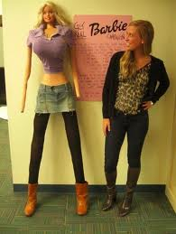
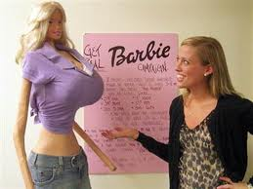

Slide 27
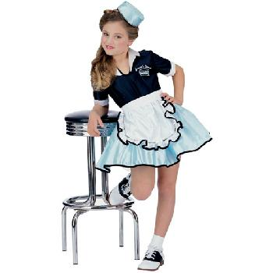
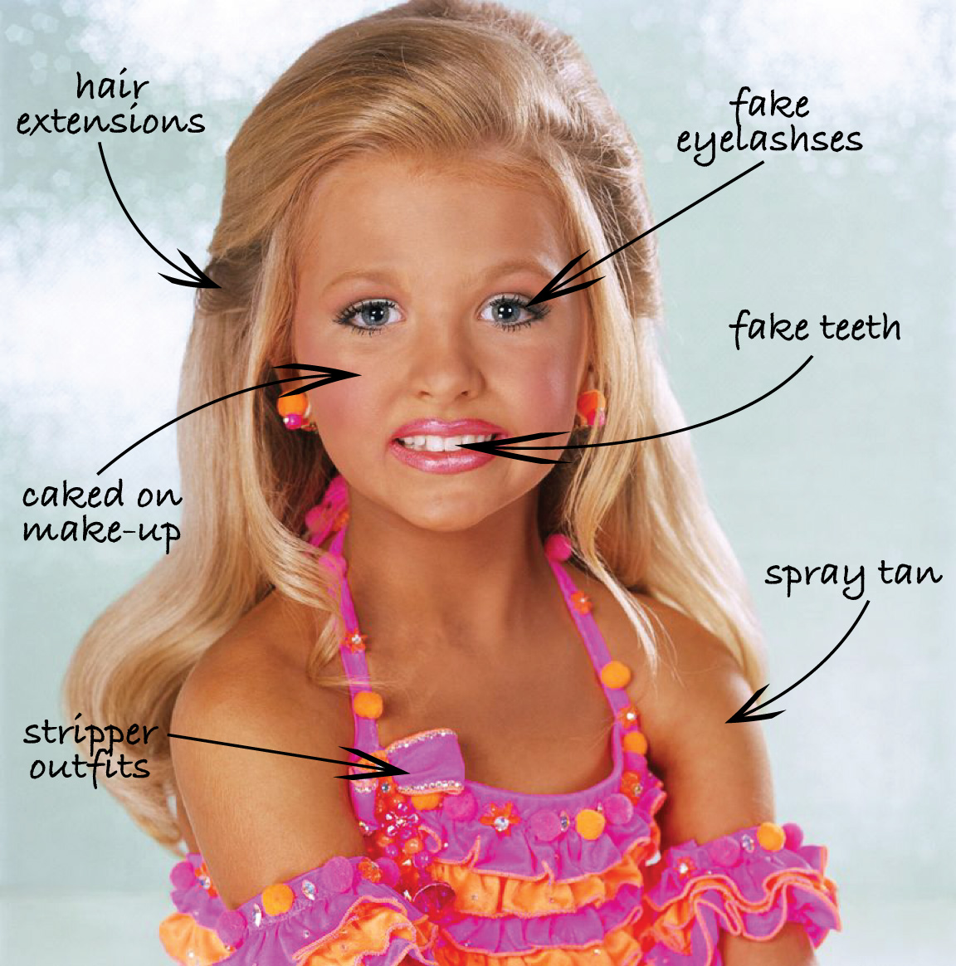

Slide 28
Super Heroes

Slide 29
Little Mermaid

Slide 30
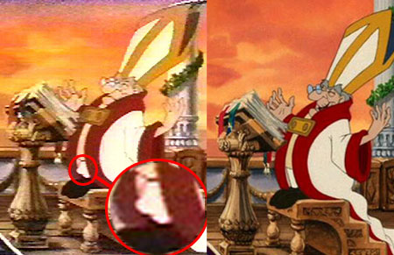
Also, from Little Mermaid

Slide 31
The Moral Of The Story

Slide 32
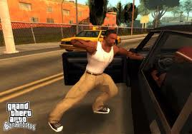
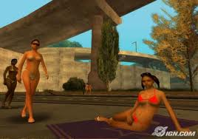
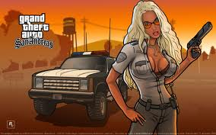
Video Games

Slide 33
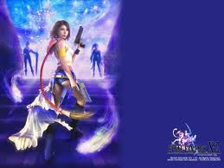
Final Fantasy

Slide 34
Dove vs. Axe
Same company different message
http://www.youtube.com/watch?v=vilUhBhNnQc
http://www.youtube.com/watch?v=mPwhMoQBg_8

Slide 36
Questions, Comments and Insights…

